Slide 1







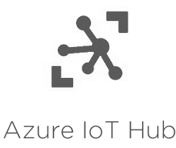


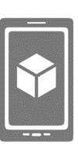



Devices
Connectivity & Management
Analytics
Storage
Tools
Presentation
Azure SQL DB
Azure ML
Power BI
Table/Blob Storage
Stream Analytics
App&Mobile service

Slide 2

Azure
Power BI
Raspberry Pi
Azure IoT hub
Stream Analytics
Azure SQL DB

Slide 3



Week 8
Week 9
Raspberry Pi
Computer Vision
Azure SQL DB
Azure Web App

Slide 4
Azure SQL DB
Azure Web App

